Slide 1
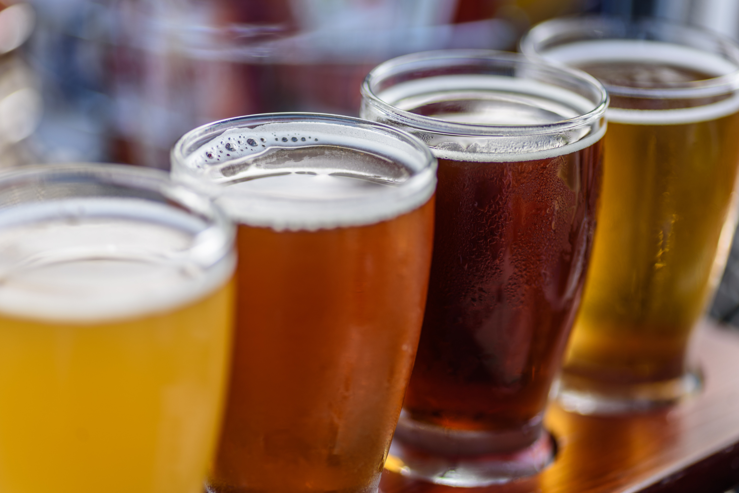
Study: Beers & Breweries
Jimena Navarro
Maya Chandrashekaran

Slide 2
Beers Dataset
Name | Beer_ID | ABV | IBU | Brewery_id | Style | Ounces
London Balling | 2685 | 0.125 | 80 | 2 | English Barleywine | 16
Csar | 2621 | 0.12 | 90 | 18 | Russian Imperial Stout | 16
4Beans | 2574 | 0.1 | 52 | 47 | Baltic Porter | 12
Lower De Boom | 1036 | 0.099 | 92 | 369 | American Barleywine | 8.4
Breweries Dataset
Brew_ID | Name | City | State
1 | NorthGate Brewing | Minneapolis | MN
2 | Against the Grain Brewery | Louisville | KY
3 | Jack's Abby Craft Lagers | Framingham | MA
4 | Mike Hess Brewing Company | San Diego | CA
5 | Fort Point Beer Company | San Francisco | CA
6 | COAST Brewing Company | Charleston | SC
7 | Great Divide Brewing Company | Denver | CO
8 | Tapistry Brewing | Bridgman | MI
9 | Big Lake Brewing | Holland | MI
10 | The Mitten Brewing Company | Grand Rapids | MI

Slide 3
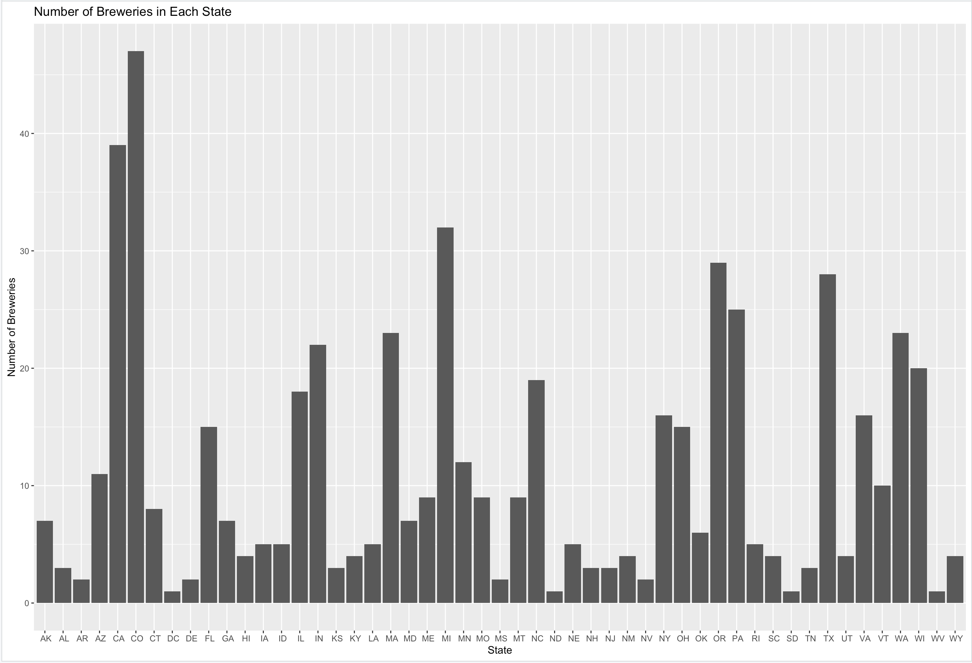
Breweries per state
Top 3 breweries:
Colorado
California
Michigan
Bottom 4 breweries:
North Dakota
DC
South Dakota
West Virginia

Slide 4
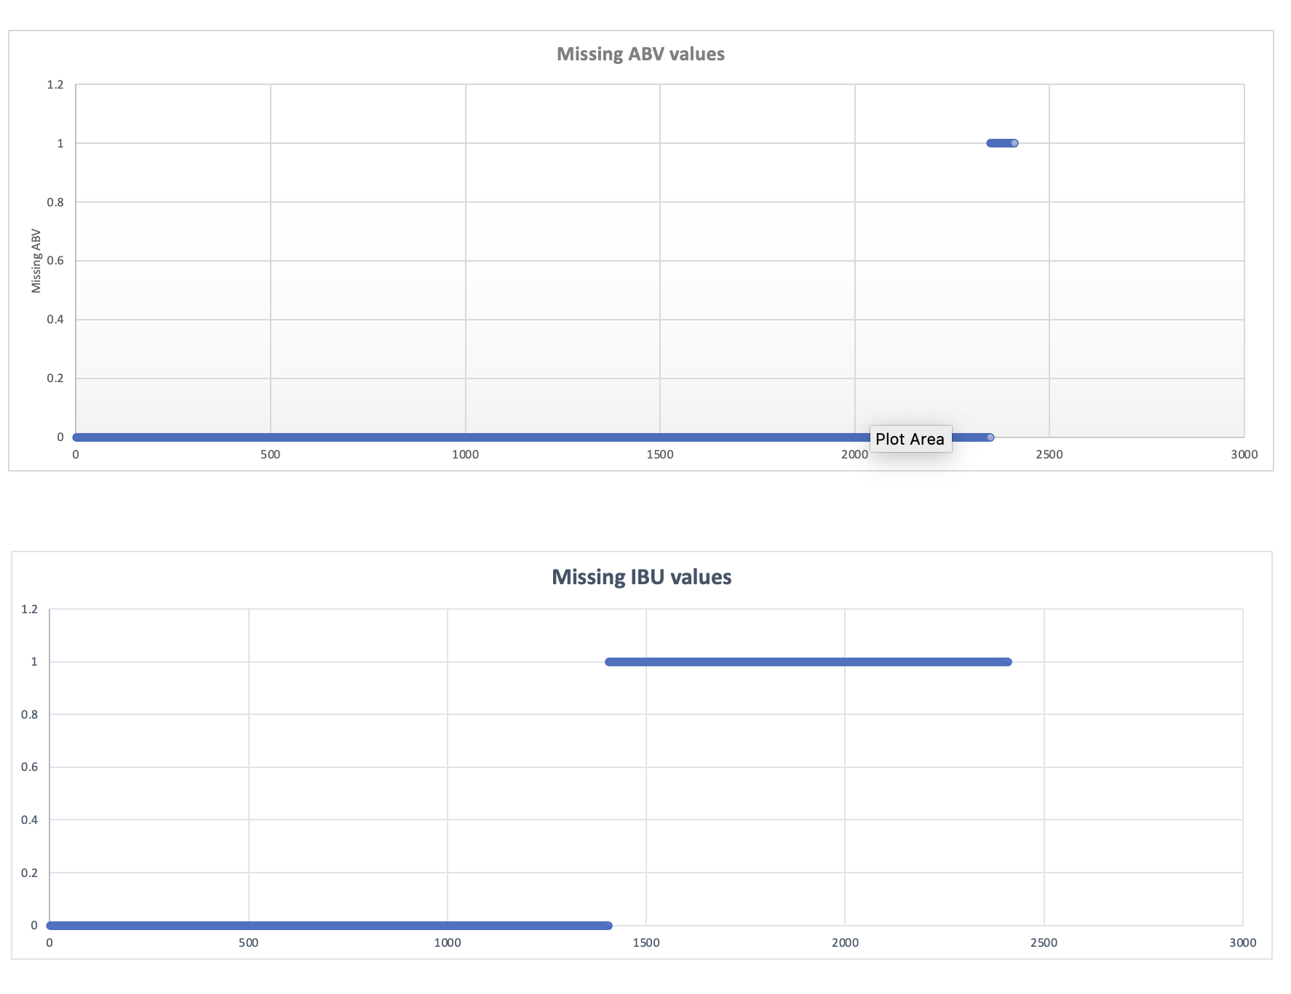
Comment on missing values
ABV
2.5% of the data missing values. All records also missing IBU values
It appears to be missing completely at random
IBU
42% of the data missing values
It appears to be missing at random
Treatment of missing values
Calculated mean ABV and IBU by Style of beer and replaced the missing values with mean
52 records had no IBU values present for all data within that style. Removed from dataset

Slide 5
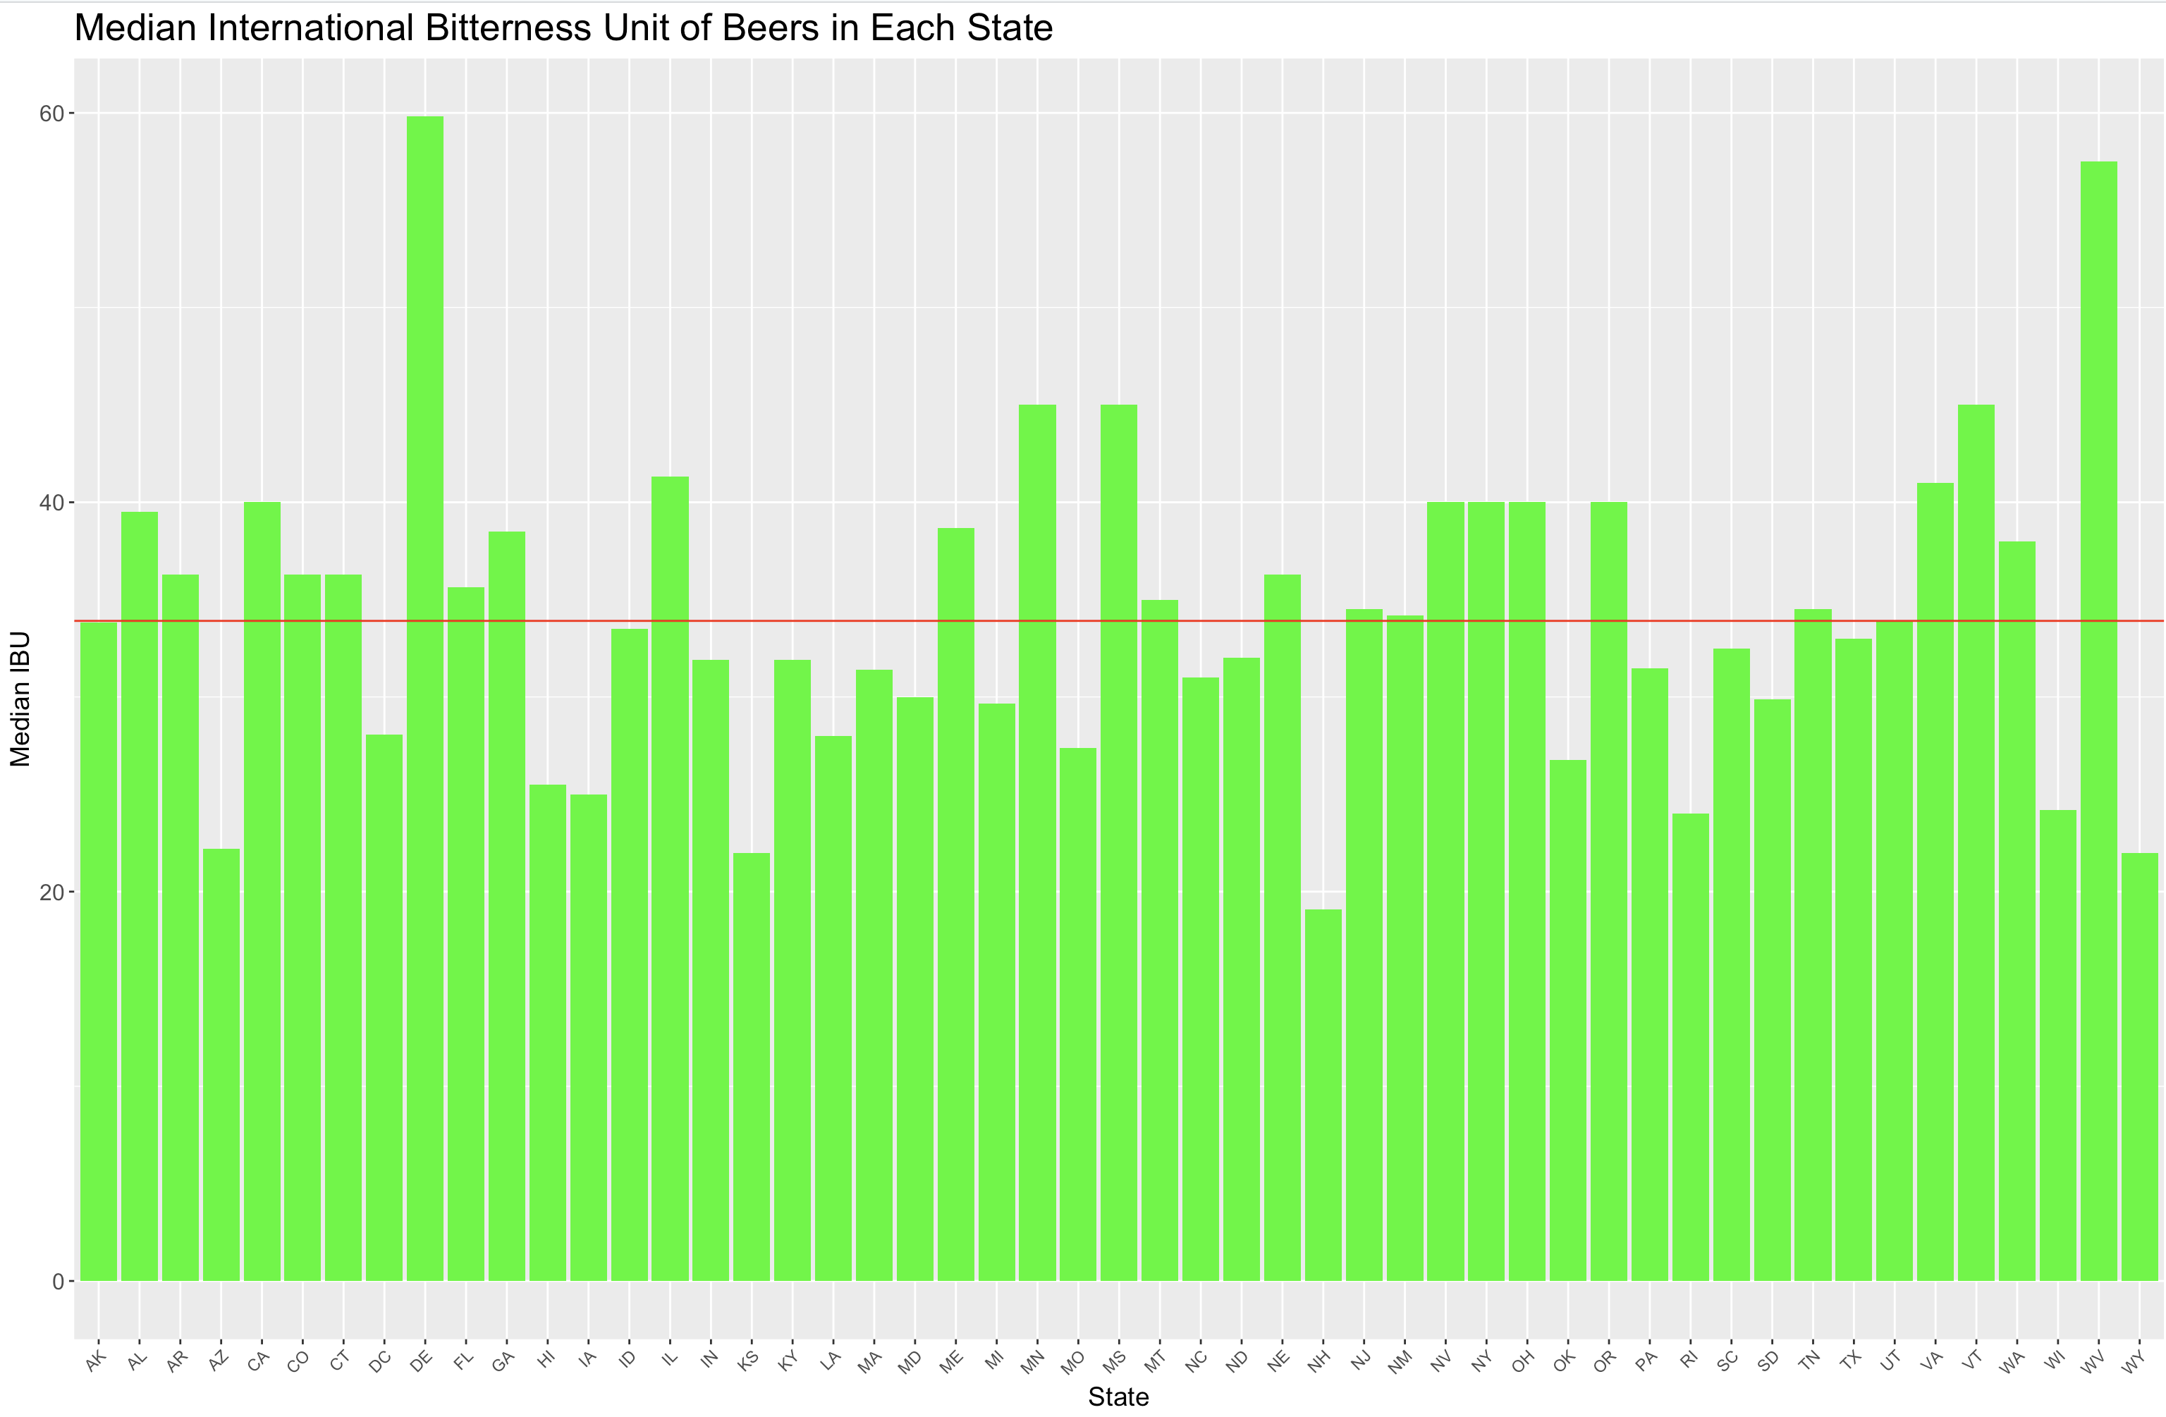
Median IBU per state
Overall Median
State with highest median of bitter beer – Delaware
State with lowest median of bitter beer – New Hampshire

Slide 6
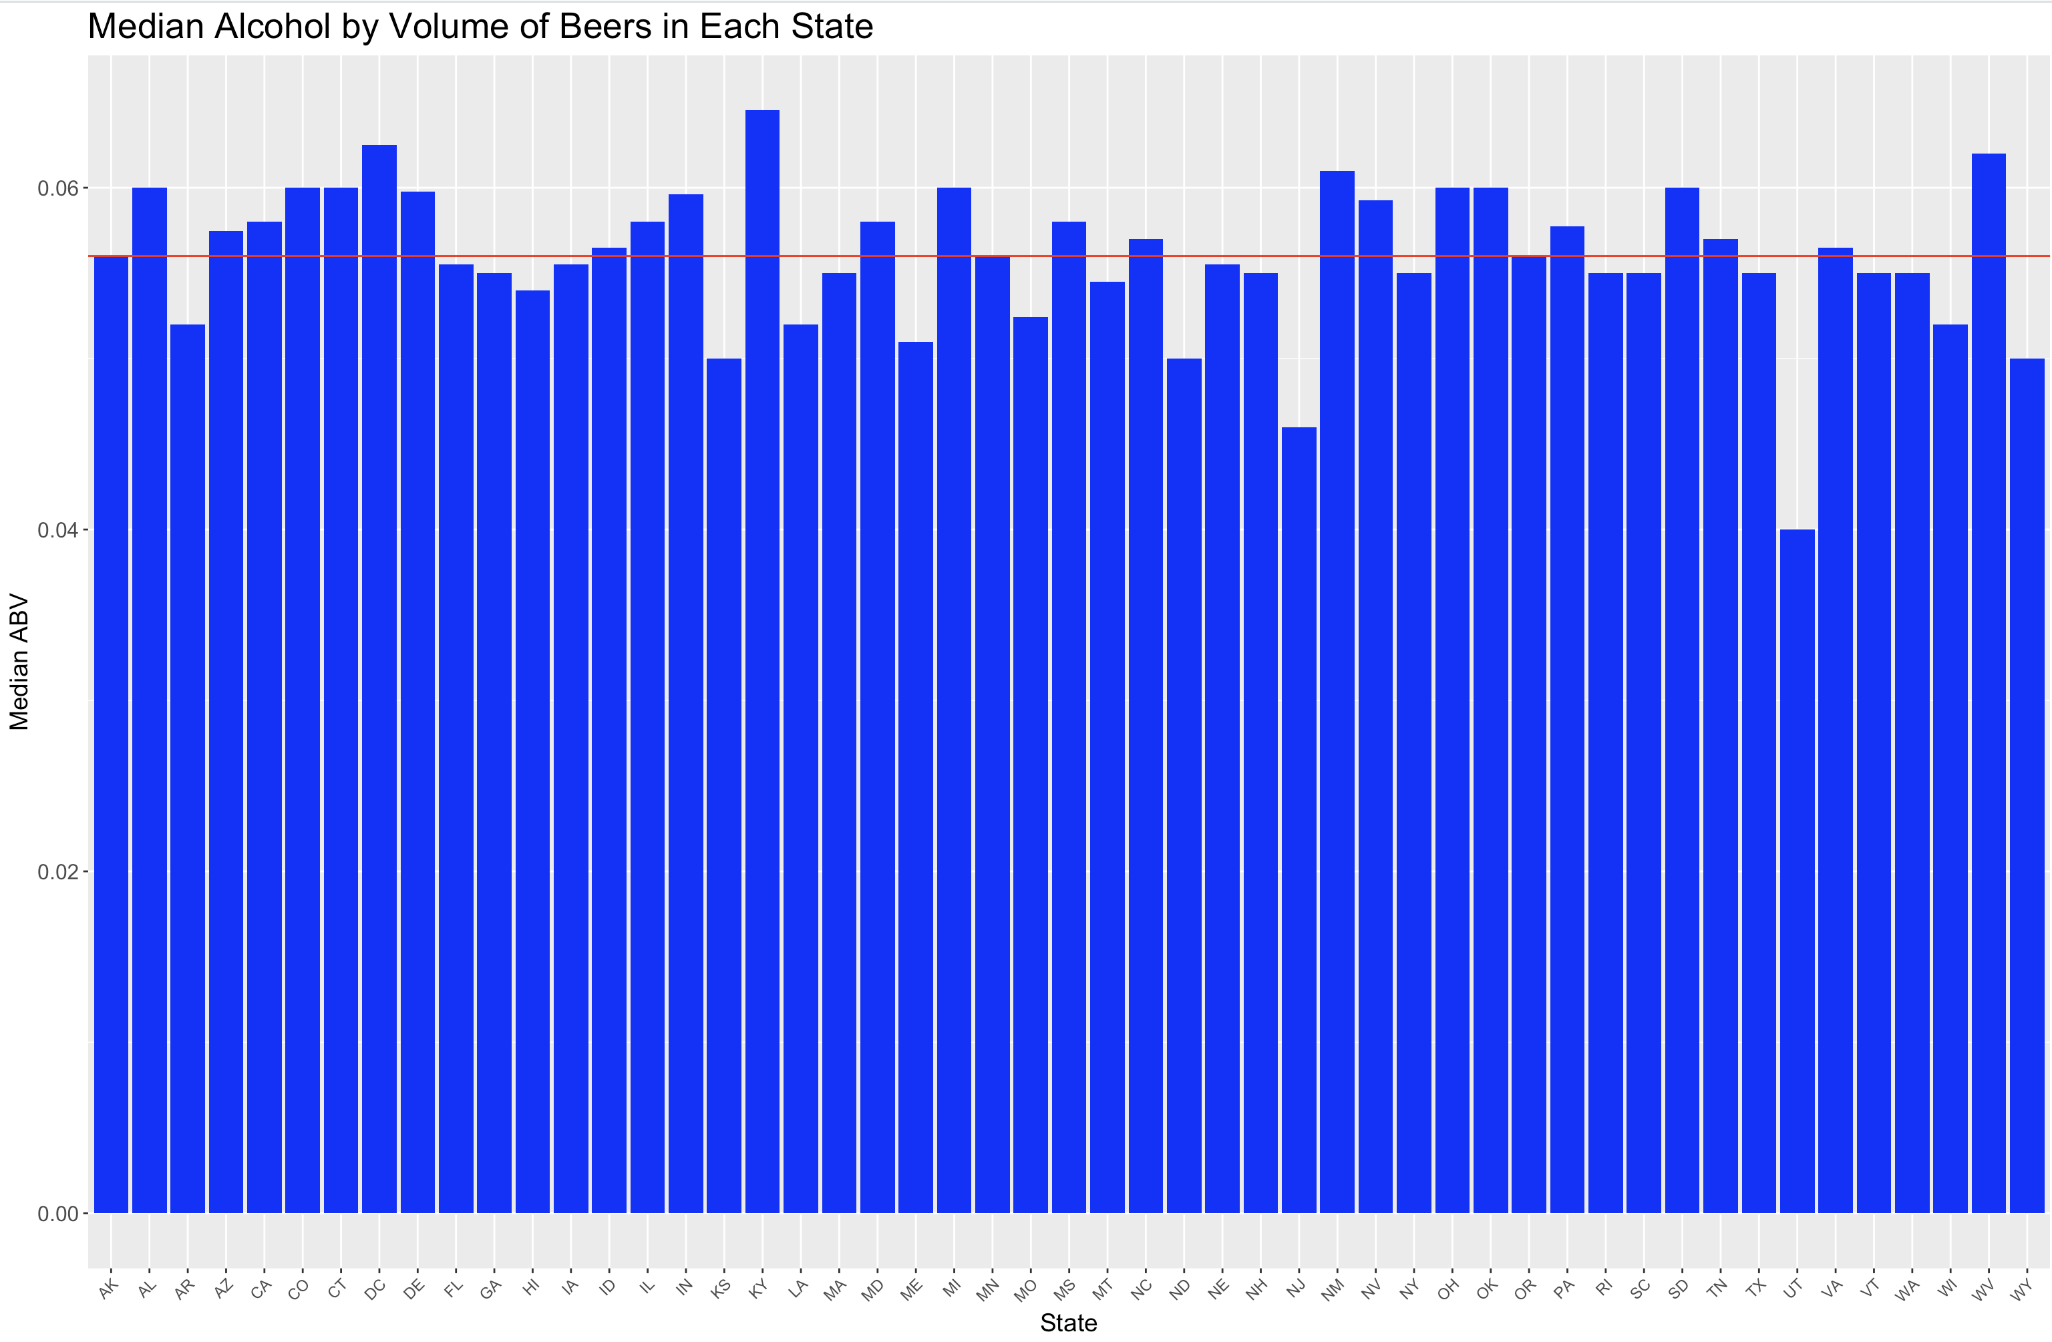
Median Alcohol Content per state
Overall Median
State with highest median of alcohol content – Kentucky
State with lowest median of alcohol content – Utah

Slide 7
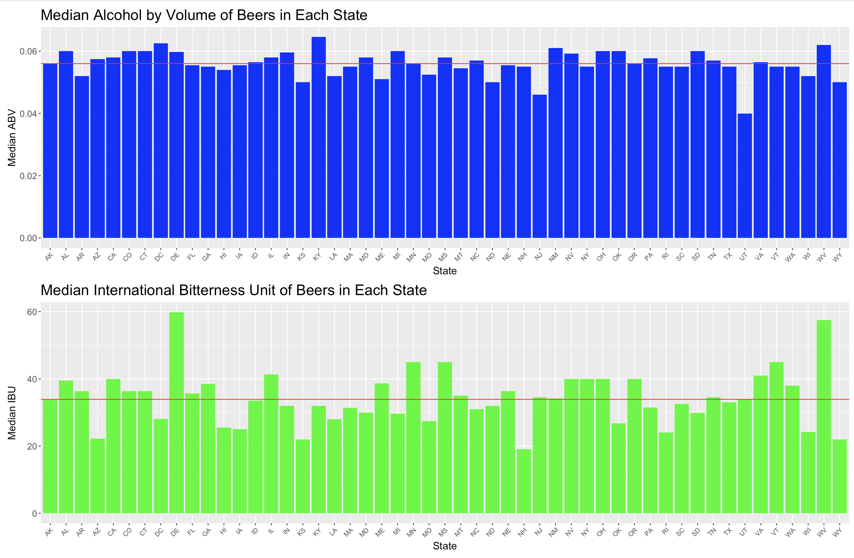
Median Alcohol Content & IBU per state
Distribution of mid-point of ABV seems tight and ranges between 4 to 6%
Distribution of mid-point IBU has more variability.

Slide 8
Maximum ABV Beer
Most bitter Beer
Colorado
ABV of 12.8%
Oregon
IBU of 138

Slide 9
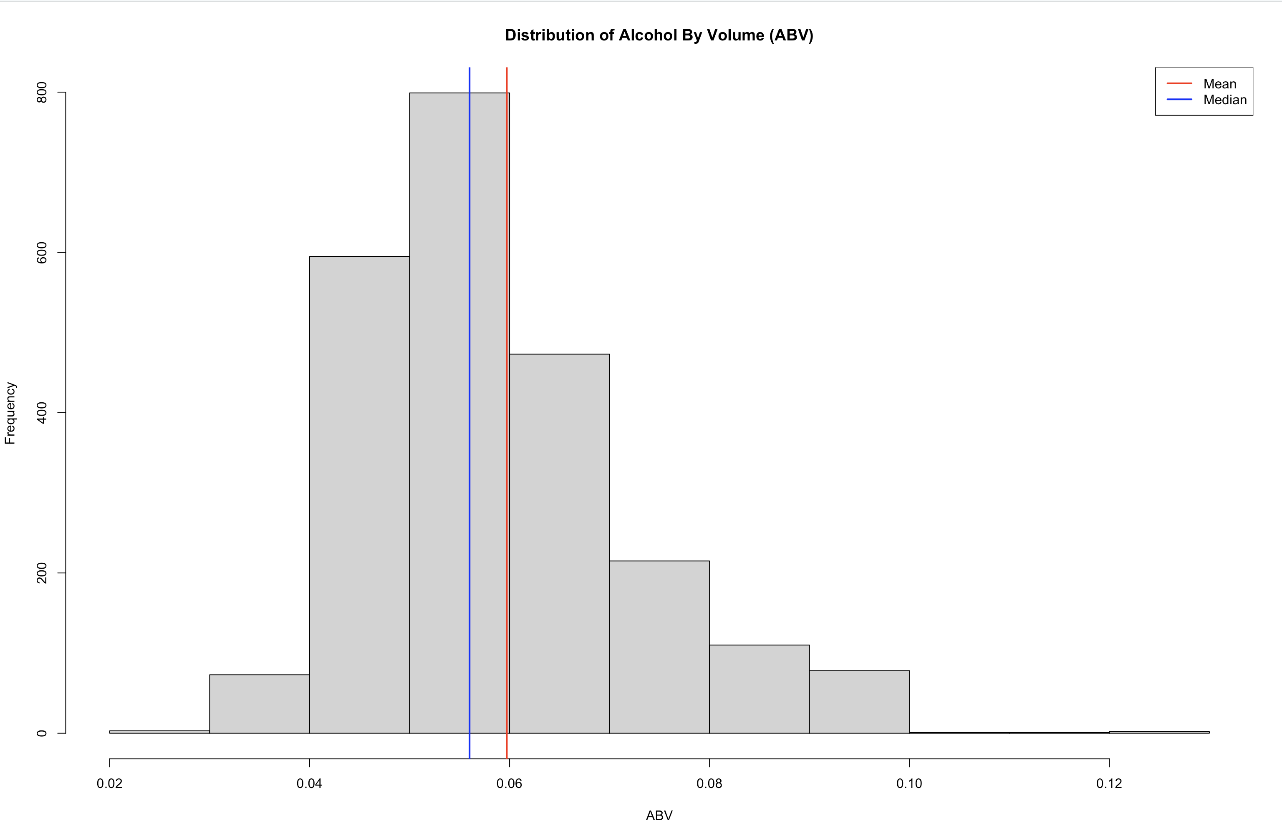
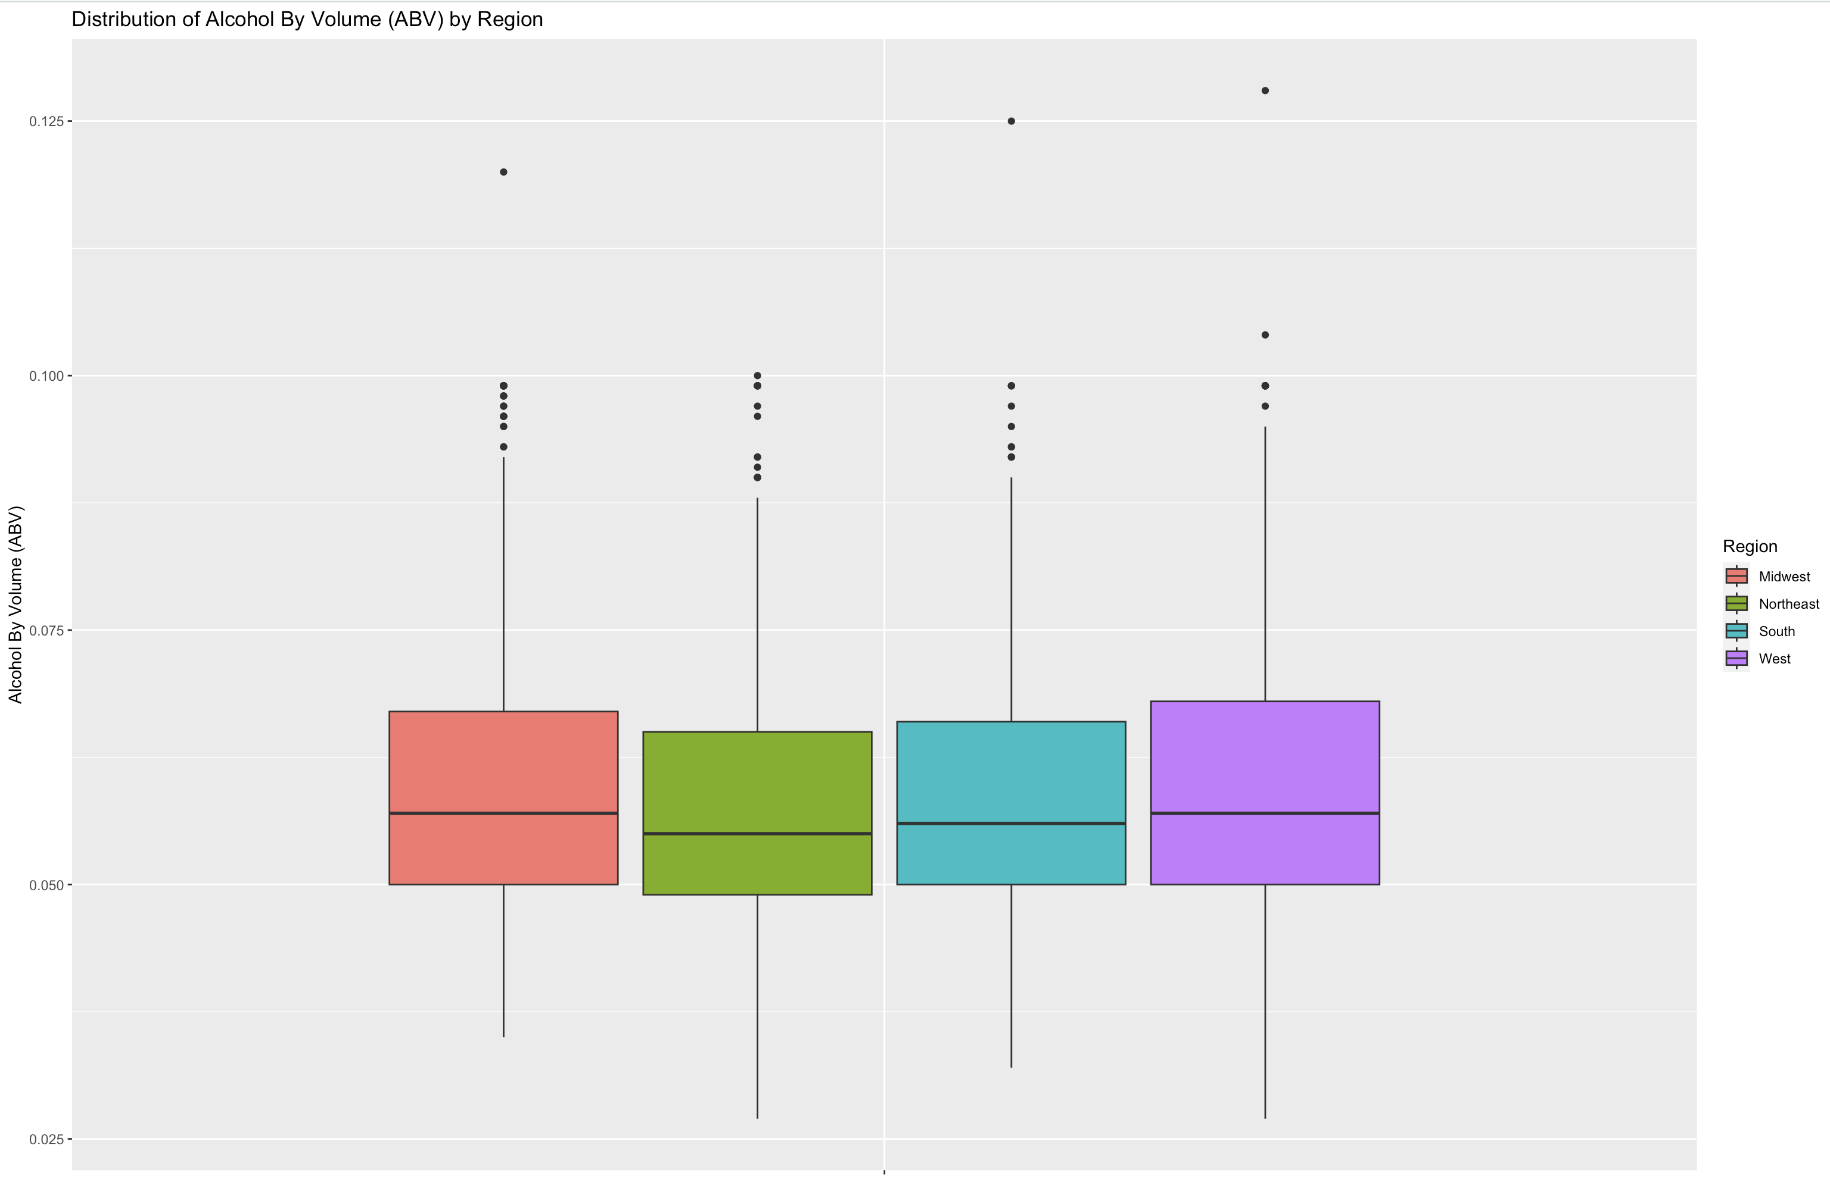
Distribution of the ABV
The distribution of ABV values appears to be right-skewed, indicating that most beers have lower alcohol content.
Half of the beers exhibit an alcohol content of 5.7% or below, with the overall range from 1% to 12.8%.
Some outliers with much higher values (>10%) than the median may represent specialty beers.

Slide 10
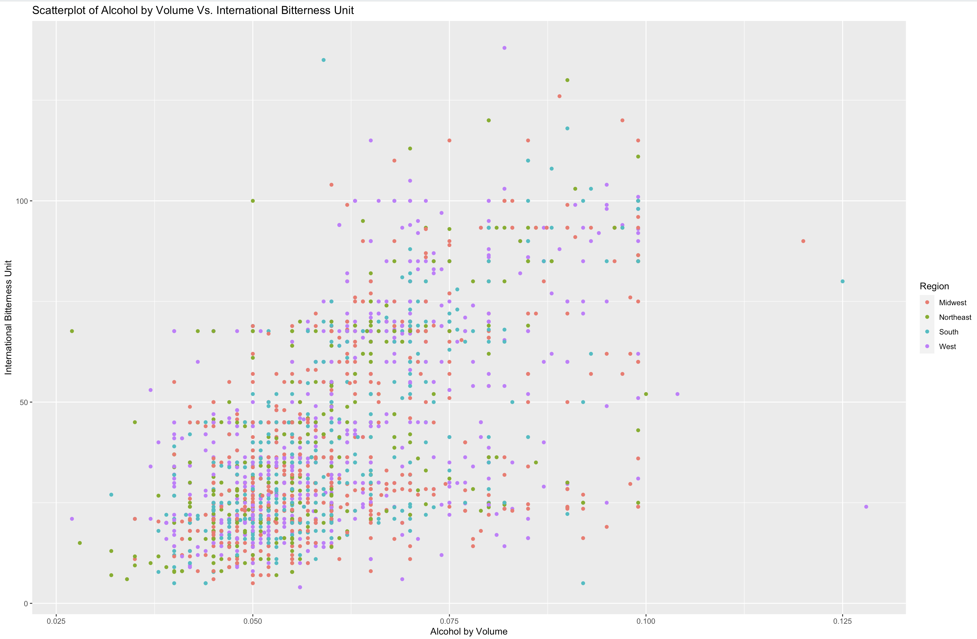
Relationship of ABV & IBU
There's a modest positive link between the two variables: beers with higher alcohol content tend to have slightly higher bitterness.
Wide scatter of data points around the trend line suggest that this positive association is weak. No patterns related to regions.

Slide 11
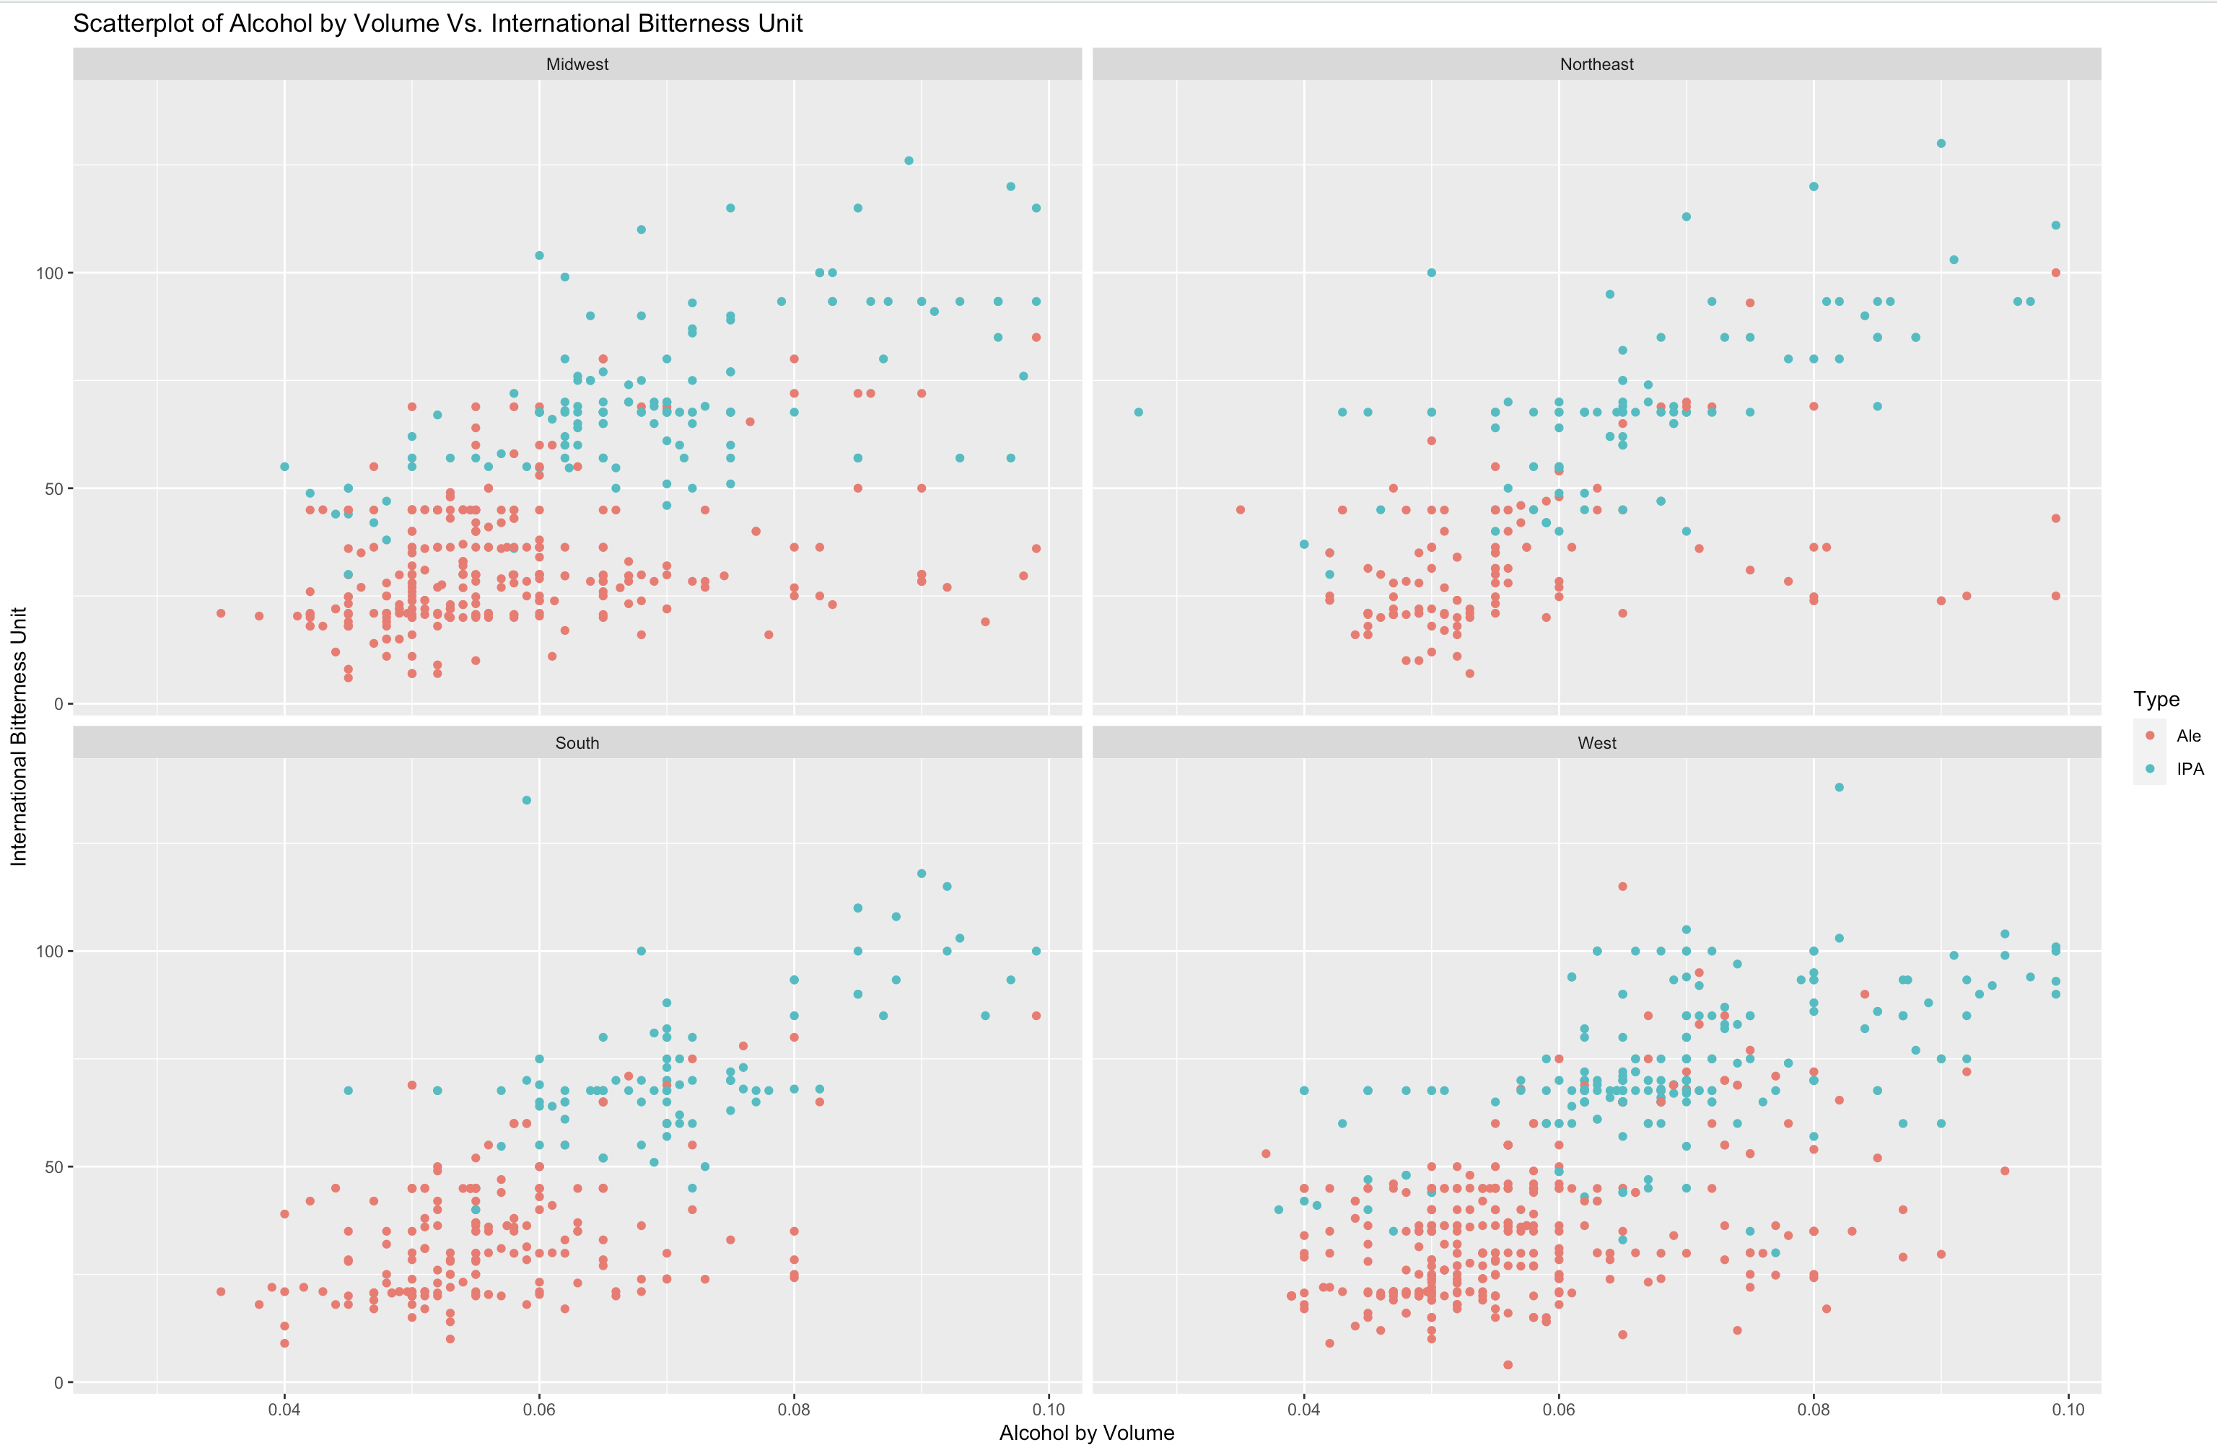
Using knn to explore relationship of ABV & IBU between IPA and other Ales
Scatterplot split by regions
Using 5 nearest neighbors to predict if beer is Ale or IPA based on ABV & IBU values

Slide 12
Using knn to explore relationship of ABV & IBU between IPA and other Ales
Classifications | Ale (actual) | IPA (actual)
Ale (predicted) | 258 | 36
IPA (predicted) | 20 | 146
Accuracy – 87.8% - General measure of model performance Of all the instances, how many were correctly classified?
Precision – 88% - proportion of true positives Of all the instances predicted as positive, how many are actually positive?
Sensitivity/ Recall – 92.8% - ability to correctly identify positive cases Of all the actual positives, how many were correctly tagged as positive?
Specificity – 80.2% - ability to correctly identify negative cases Of all the actual negative cases, how many were correctly classified as negative
F1 – Score – 90.2% - harmonic mean of precision and recall.

Slide 13
Using naïve bayes to explore relationship of ABV & IBU between IPA and other Ales
Classifications | Ale (actual) | IPA (actual)
Ale (predicted) | 243 | 34
IPA (predicted) | 35 | 148
Accuracy – 85% - General measure of model performance Of all the instances, how many were correctly classified?
Precision – 87.8% - proportion of true positives Of all the instances predicted as positive, how many are actually positive?
Sensitivity/ Recall – 87.4% - ability to correctly identify positive cases Of all the actual positives, how many were correctly tagged as positive?
Specificity – 81.3% - ability to correctly identify negative cases Of all the actual negative cases, how many were correctly classified as negative
F1 – Score – 87.6% - harmonic mean of precision and recall.

Slide 14
Comparison of models - naïve Bayes and knn
Classification Models | Precision | Sensitivity/ Recall | F1-Score
knn | 88% | 92.8% | 90.2%
naïve bayes | 87.8% | 87.4% | 87.6%
Both models’ outcome is comparable. knn may be preferred in this case because of the higher F1 score.
Precision - proportion of true positives Of all the instances predicted as positive, how many are actually positive?
Sensitivity/ Recall - ability to correctly identify positive cases Of all the actual positives, how many were correctly tagged as positive?
F1 – Score - harmonic mean of precision and recall.

Slide 15
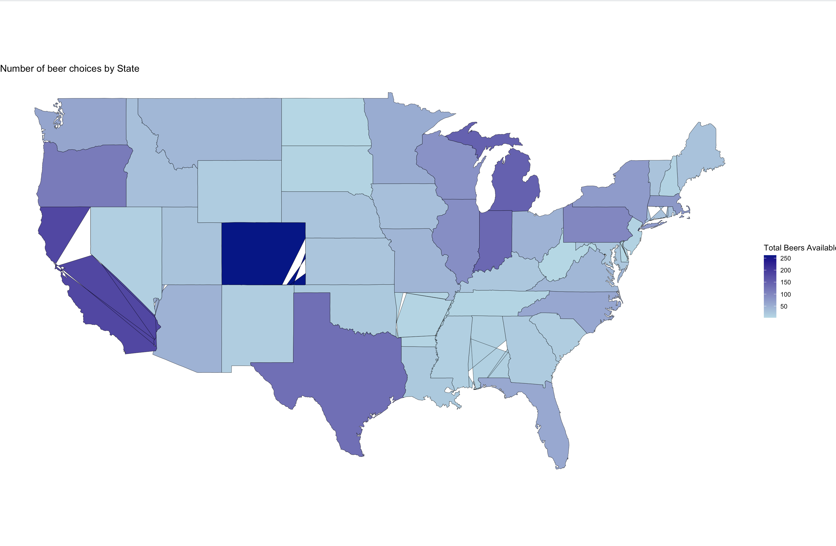
Additional insights – Opportunity to introduce beer options
Opportunities
Top 5 states (less than 3 beers)
Mississippi (MS)
Nevada (NV)
West Virginia (WV)
South Dakota (SD)
DC
SD
NV
CO
DC
WV
CA
MS

Slide 16
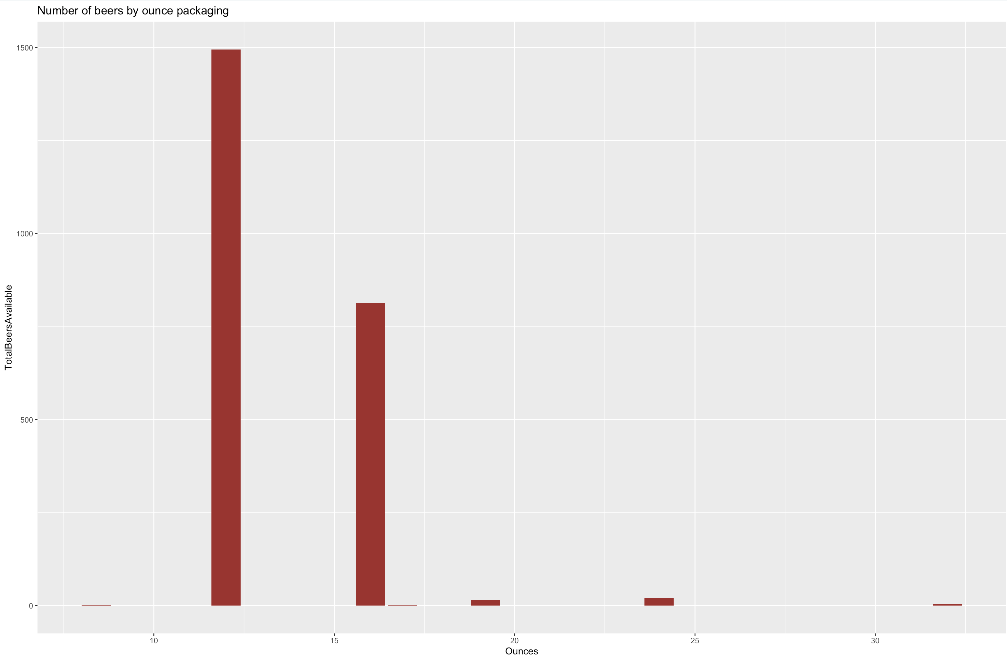
Additional insights – Packaging for introducing beer options
12 ounces
Packaging consideration
Most popular is 12 ounces, followed by 16 ounces.
Consider choosing between these options when expanding across the US.
16 ounces

Slide 17
"Beer is the answer...but I can't remember the question.” - unknown

Slide 18
Thank you!
contacts
jnavarro@smu.edu mchandrashekaran@smu.edu

Slide 19
Appendix
Video link and ChatGPT commentary

Slide 20
Link to video -
Beers&Breweries.mp4 – Link to Stream, access for SMU email users only.

Slide 21
ChatGPT
Here is where we found ChatGPT to be useful:
debug code
sharing the right syntax for a function
explaining concepts (e.g., difference between sensitivity & specificity measures in the confusion matrix)
ideas on different graphs we could use to tell the story
options on rephrasing sentences to express the idea more clearly
Errors/challenges with ChatGPT
using the code from ChatGPT can be cumbersome, when you must rename data frames throughout the code.
lot of iterations on the prompting for certain questions to ensure chatGPT understands what is being requested

